Slide 1
Radio Frequency Signal Generator
By: Ethan Cura, Abel Gonzalez, Joseph Hinz and James Taylor
Notes:
James

Slide 2
Summary
The goal of this project is to supplement the existing market with a low-cost RF signal generator for students and enthusiasts.
The signal generator shall have a frequency range between 1 and 500MHz with 1Hz precision.
The signal generator shall be able to frequency and amplitude modulate this carrier frequency.
The signal generator shall minimize any spurious signals for a spectrally pure output.
Notes:
Abel

Slide 3
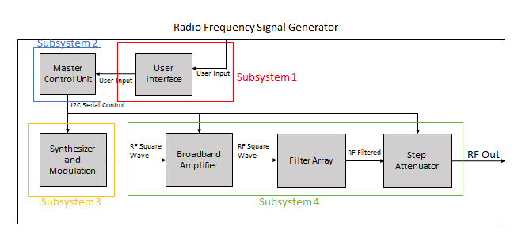
System Overview
Notes:
Ethan

Slide 4
ECEN 404 Progress

Slide 5
Subsystem 1:
Purchased and adapted a metal housing to hold all PCB's and support necessary IO ports
Designed and built a PCB to interface the MCU with all other subsystems
Designed and built a PCB to mount two rotary encoders to the front panel (unused)

Slide 6
Subsystem 2:
Developed code to interface the MCU with all other boards/components via I2C and digital IO.
Developed a menu system for the instrument using an LCD screen and numpad
Menu allows the user to control instrument frequency, power and output mode

Slide 7
Subsystem 3:
Mostly completed at the start of ECEN 404
Integrated with the MCU and Subsystem 3 with no problems

Slide 8
Subsystem 4:
Finished assembling the three filter boards
Assembled amplifer board
Designed and assembled attenuator board

Slide 9
Integrated System Operation

Slide 10
Overview
1-128MHz frequency range (original: 1-500MHz)
1Hz frequency precision (original: 1Hz frequency precision)
-30dBc for most unwanted harmonics, -20dBc for some (original: -30dBc)
-43 to 10dBm power range (original: -100 to 10dBm)

Slide 11
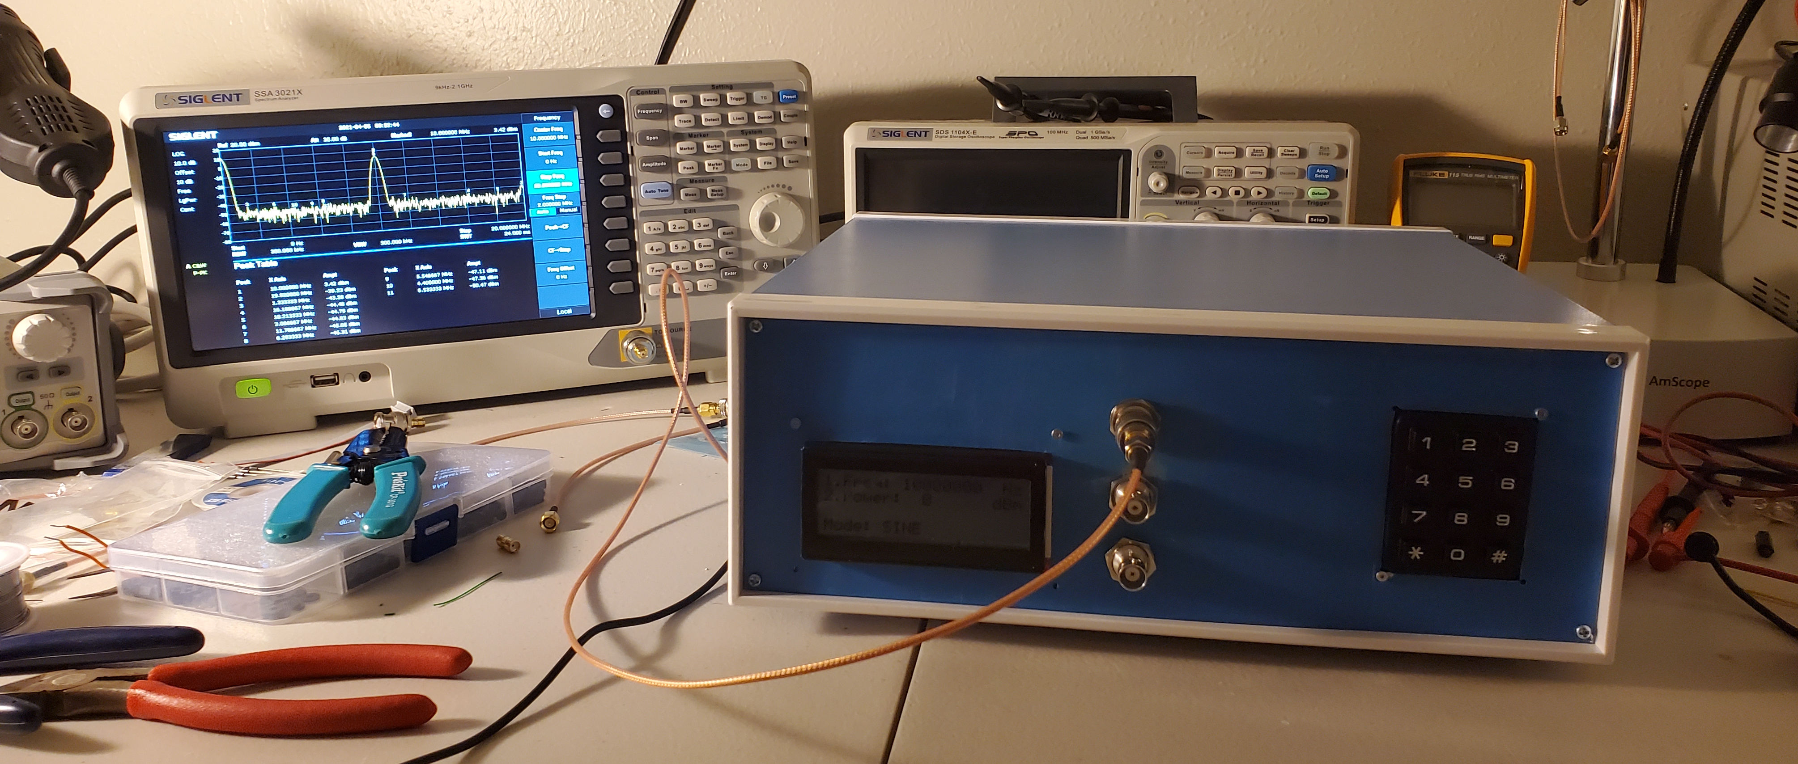
Complete Instrument

Slide 12
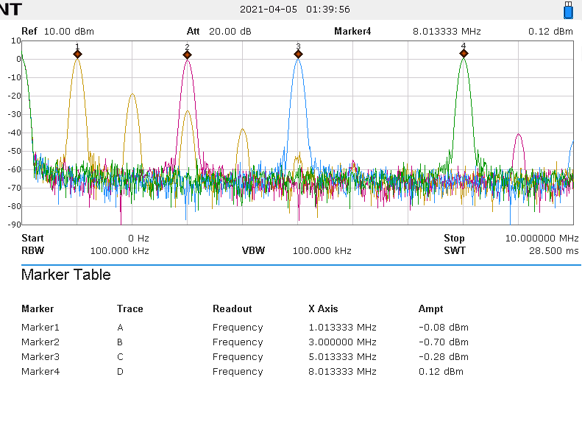
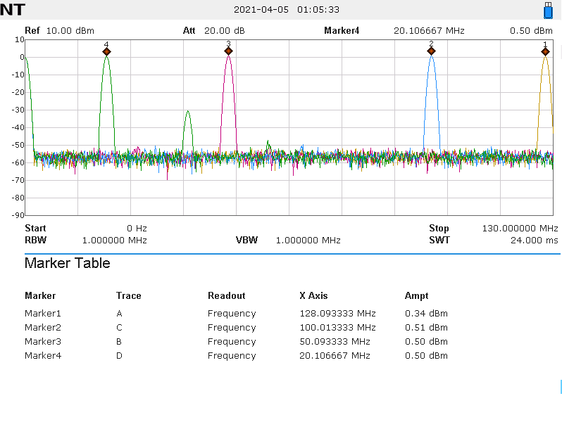
Frequency Range (1-128MHz)

Slide 13
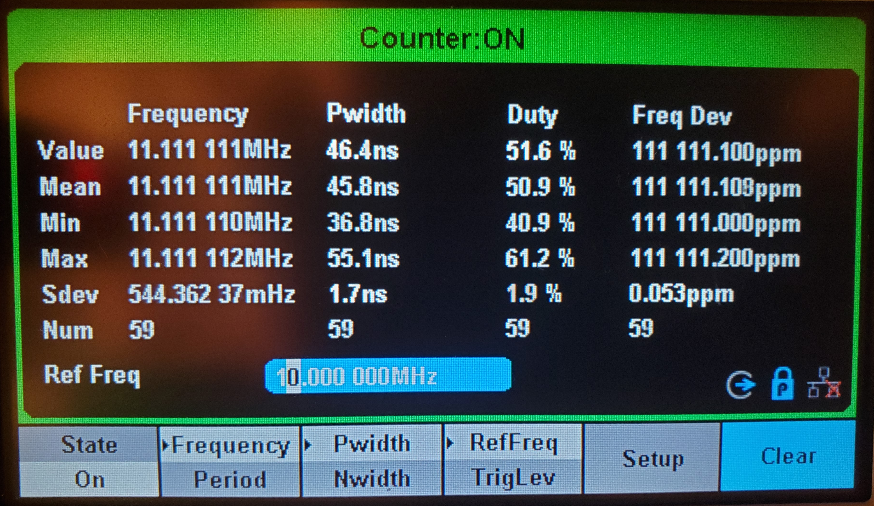
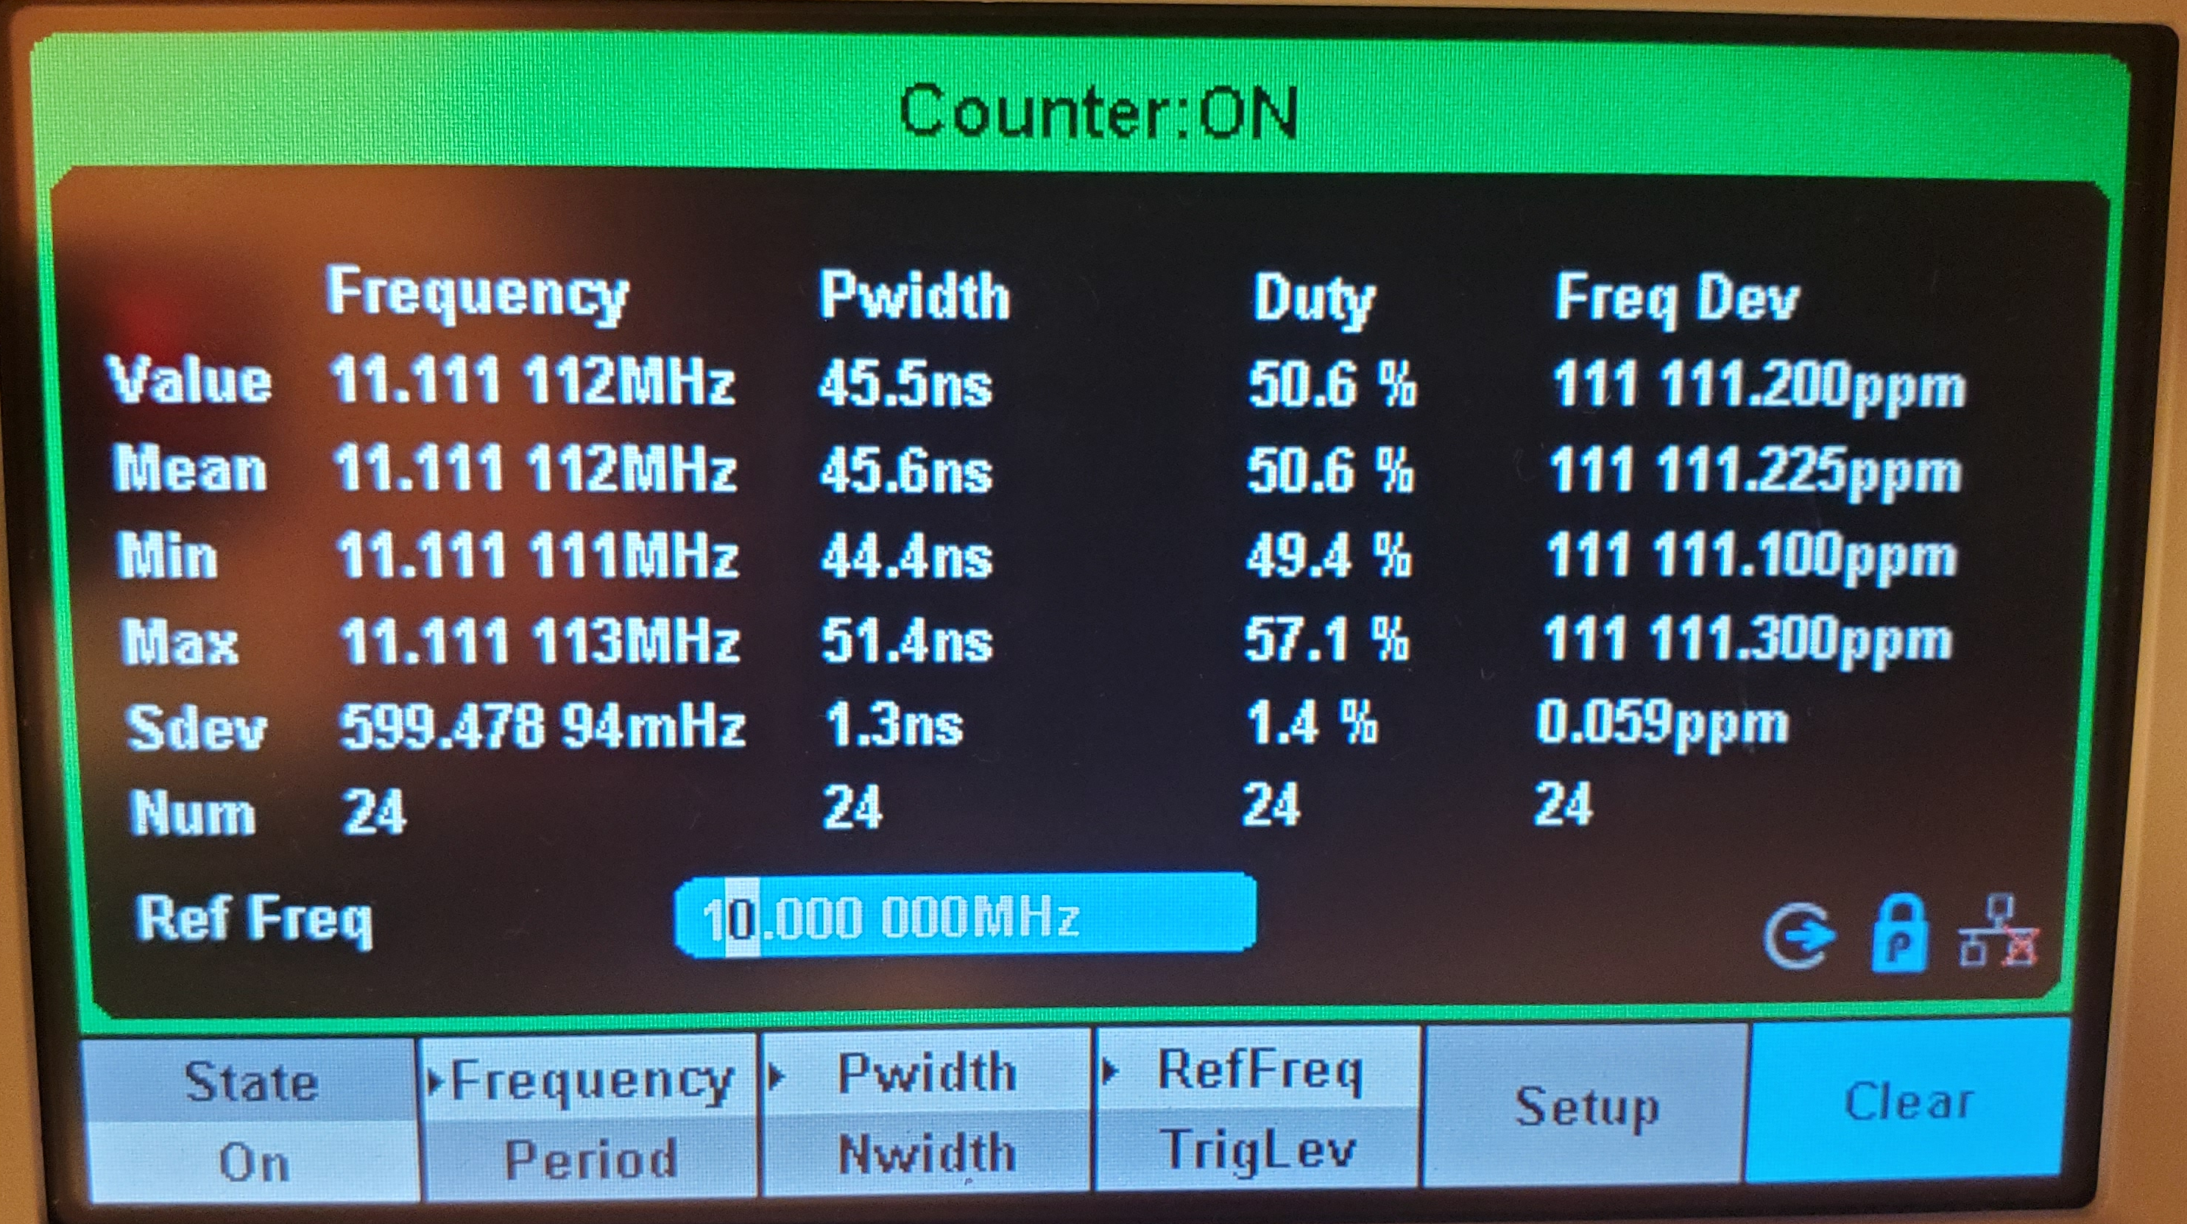
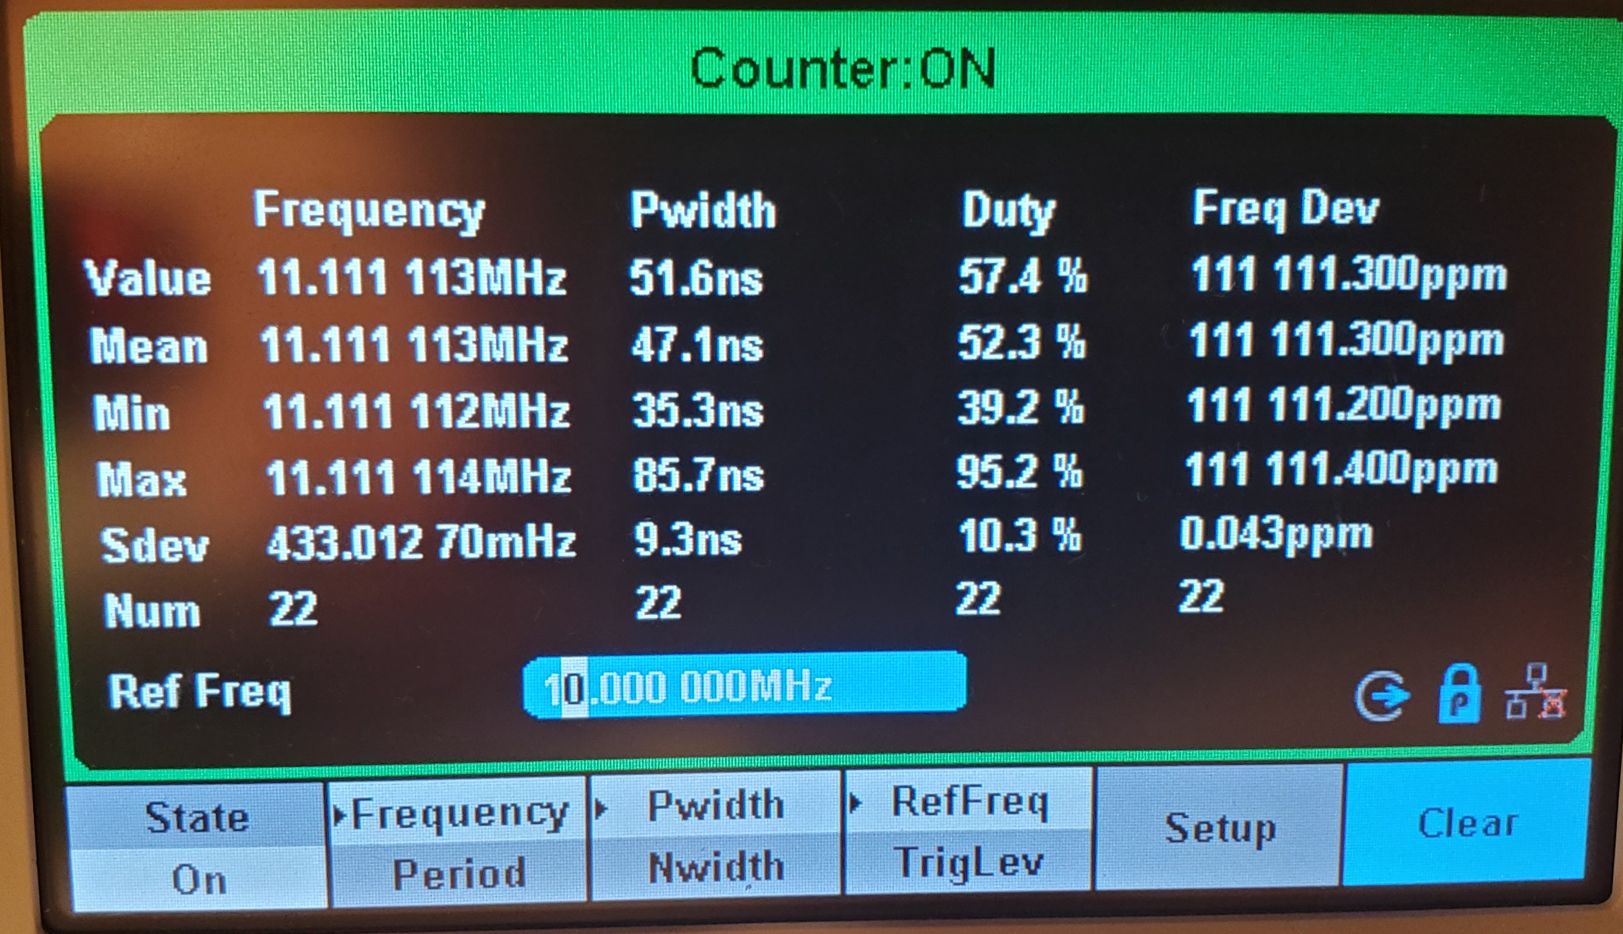
Frequency Precision (1Hz)

Slide 14
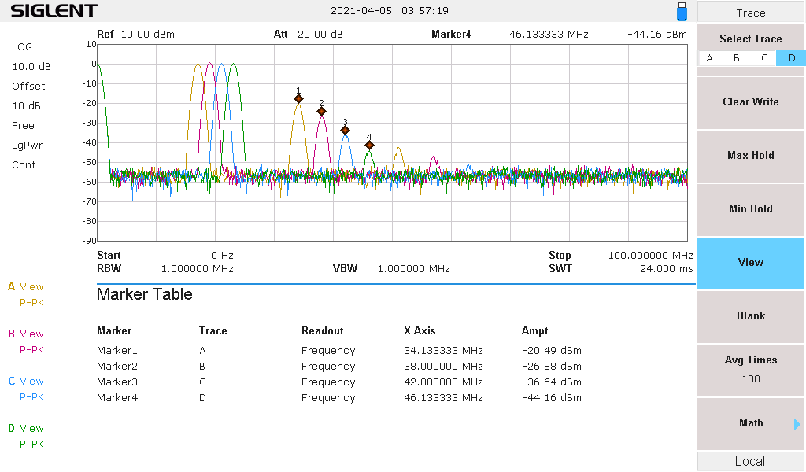
Spectral Purity

Slide 15
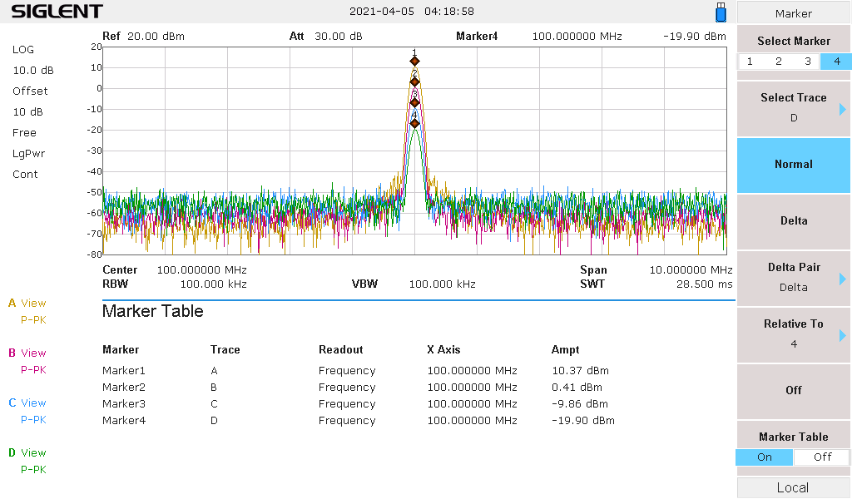
Output Power Range (10 to –20dBm)

Slide 16
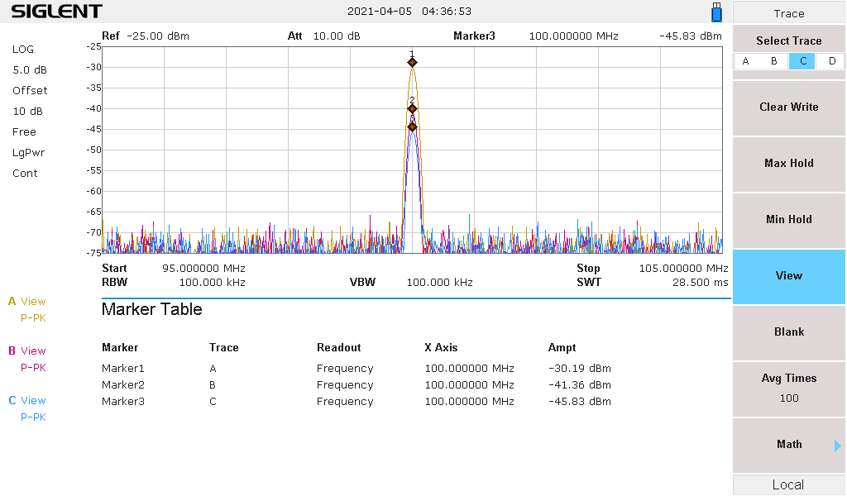
Output Power Range (-20 to –45dBm)

Slide 17
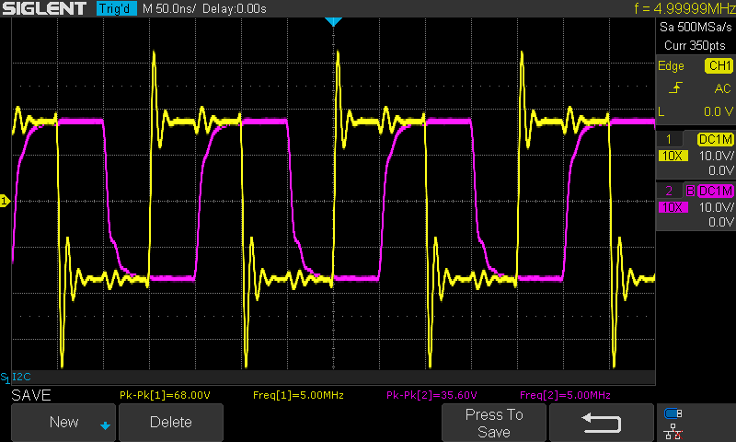
In-Phase & Quadrature Output

Slide 18
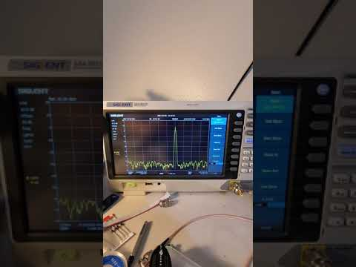
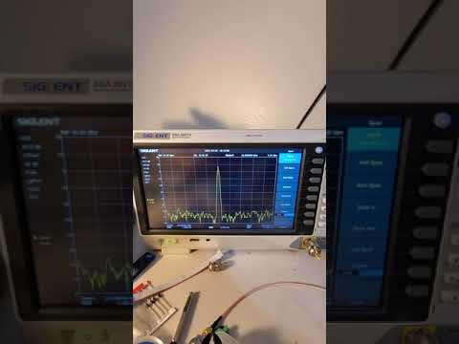
Frequency and Amplitude Modulation

Slide 19
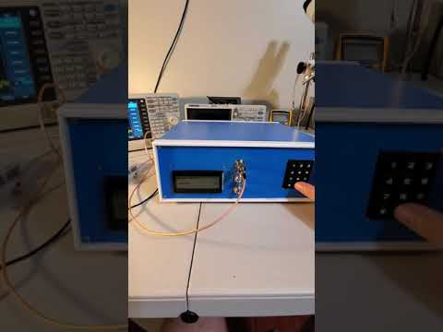
General Operation: Setting a frequency

Slide 20
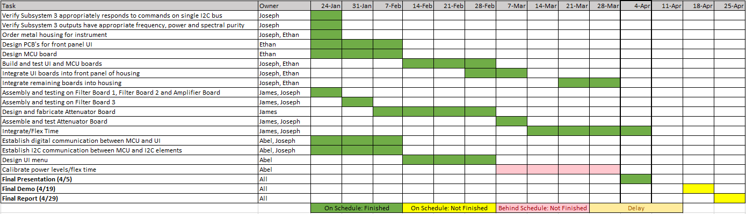
Integration Timeline

Slide 21
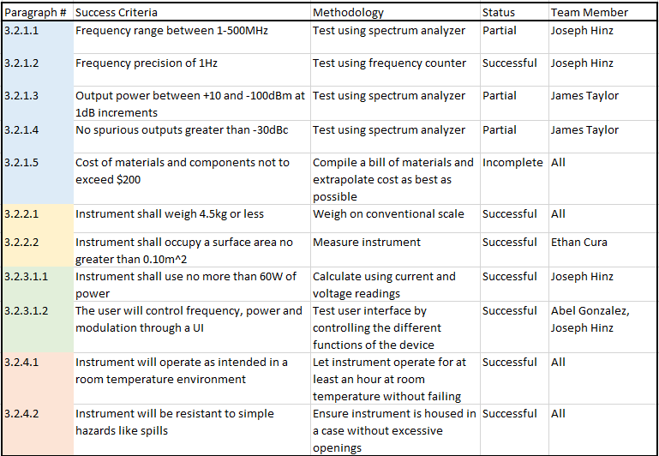
Validation Plan

Slide 22
Takeaways
Managing high frequency signals requires significant attention to detail and planning
Finishing subsystems as early as possible allows mistakes to be corrected
Carefully selecting parts in the beginning will result in fewer problems in the future
It is important to consider how your PCBs will fit in your design physically, not just electrically

Slide 23
Thank You

Slide 24
Questions

